Slide 1
Lecture V
Simulated Annealing Algorithm
(Advanced Stochastic Local Search)

Slide 2
Problem: Iterative Improvement stops at Local
minima, which can be very “poor”.
Strategies are required to prevent the search from getting trapped in local minima and to escape from them.

Slide 3
Three basic ideas
1) Accept up-hill moves
i.e., the search moves toward a solution with a worse objective function value
Intuition: climb the hills and go downward in another direction
2) Change neighborhood structure during the search
Intuition: different neighborhoods generate different search space topologies
3) Change the objective function so as to “fill-in” local minima
Intuition: modify the search space with the aim of making more “desirable” not yet explored areas

Slide 4
Simulated Annealing
Simulated Annealing exploits the first idea:
accept also up-hill moves.
Origins in statistical mechanics (Metropolis algorithm)
It allows moves resulting in solutions of worse quality than the current solution
The probability of doing such a move is decreased during the search.

Slide 5
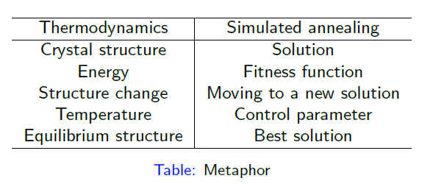

Slide 6
Simulated Annealing
Can be interpreted as a modified random descent in the space of solutions
Choose a random neighbor
Improving moves are always accepted
Deteriorating moves are accepted with a probability that depends on the amount of the deterioration and on the temperature (a parameter that decreases with time)
Can escape local optima

Slide 7
Move Acceptance in SA
We assume a minimization problem
Set Δ = Obj(random neighbor) – Obj(current solution)
If Δ < 0 → accept (we have an improving move)
Else accept if
If the move is not accepted: try another random neighbor

Slide 8
Convergence of simulated annealing

Slide 9
Ball on terrain example – SA vs Greedy Algorithms

Slide 10
To accept or not to accept - SA?
P = exp(-c/t) > r
Where
c is change in the evaluation function
t the current temperature
r is a random number between 0 and 1
Example

Slide 11
To accept or not to accept - SA?

Slide 13
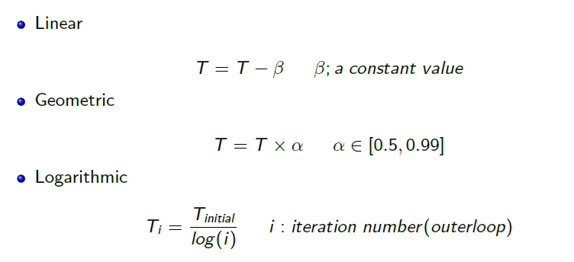
SA - Structure
Initial temperature t₀ high
(if ∞ → random walk)
Reduce t regularly
need a cooling schedule
if too fast → stop in some local optimum too early
if too slow → too slow convergence
Might restart
Choice of neighborhood structure is important

Slide 14
SA
Statistical guarantee that SA finds the global optimum
In practice this requires exponential (or ∞) running time
The cooling schedule is vitally important
Much research on this
Static schedules: specified in advance
Adaptive schedules: react to information from the search

Slide 15
Simulated Annealing
Step 1: Initialize – Start with a random initial placement. Initialize a very high “temperature”.
Step 2: Move – Perturb the placement through a defined move.
Step 3: Calculate score – calculate the change in the score due to the move made.
Step 4: Choose – Depending on the change in score, accept or reject the move. The prob of acceptance depending on the current “temperature”.
Step 5: Update and repeat– Update the temperature value by lowering the temperature. Go back to Step 2.
The process is done until “Freezing Point” is reached.

Slide 16
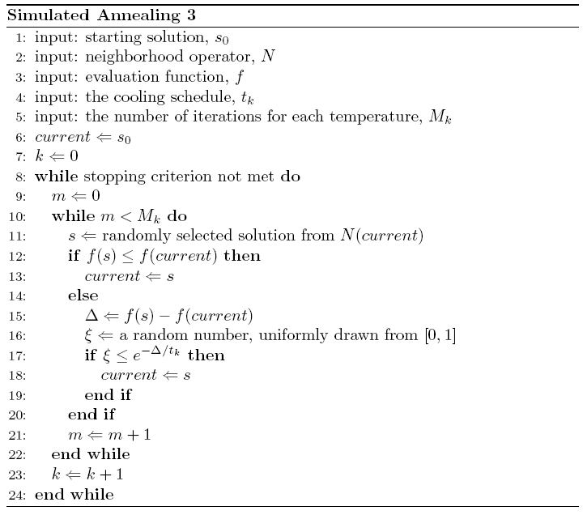

Slide 17
Choice of Move in SA
Modified ”Random Descent”
Select a random solution in the neighborhood
Accept this
Unconditionally if better than current
With a certain, finite probability if worse than current
The probability is controlled by a parameter called the temperature
Can escape from local optima

Slide 18
SA - Cooling
Random Walk
Random Descent

Slide 19
SA – Overall Structure
Set the initial value of the control variable t (t₀) to a high value
Do a certain number of iterations with the same temperature
Then reduce the temperature
Need a ”cooling schedule”
Stopping criterion – e.g. ”minimum temperature”
Repetition is possible
Solution quality and speed are dependent on the choices made
Choice of neighborhood structure is important

Slide 20
Statistical Analysis of SA
Model: State transitions in the search space
Transition probabilities [p_{ij}] (i,j are solutions)
Only dependent on i and j: homogenous Markov chain
If all the transition probabilities are finite, then the SA search will converge towards a stationary distribution, independent of the starting solution.
When the temperature approaches zero, this distribution will approach a uniform distribution over the global optima
Statistical guarantee that SA finds a global optimum
But: exponential (or infinite) search time to guarantee finding the optimum

Slide 21
SA in Practice (1)
Heuristic algorithm
Behaviour strongly dependent on the cooling schedule
Theory:
An exponential number of iterations at each temperature
Practice:
A large number of iterations at each temperature, few temperatures
A small number of iterations at each temperature, many temperatures

Slide 22
SA in Practice (2)
Geometric chain
t_{i+1} = α t_{i}, i = 0,…,K
α <1 (0.8 - 0.99)
Number of repetitions can be varied
Adaptivity:
Variable number of moves before the temperature reduction
Necessary to experiment

Slide 23
SA – General Decisions
Cooling Schedule
Based on maximum difference in the objective function value of solutions, given a neighborhood
Number of repetitions at each temperature
Reduction rate, α
Adaptive number of repetitions
more repetitions at lower temperatures
number of accepted moves, but a maximum limit
Very low temperatures are not necessary
Cooling rate most important

Slide 24
SA – Problem Specific Decisons
Important goals
Response time
Quality of the solution
Important choices
Search space
Infeasible solutions – should they be included?
Neighborhood structure
Move evaluation function
Use of penalty for violated constraints
Approximation – if expensive to evaluate
Cooling schedule

Slide 25
SA – Choice of Neighborhood
Size
Variation in size
Topologi
Symmetry
Connectivity
Every solution can be reached from all the others
Topography
Spikes, Plateaus, Deep local optima
Move evaluation function
How expensive is it to calculate ?

Slide 26
SA - Speed
Random choice of neighbor
Reduction of the neighborhood
Does not search through all the neighbors
Cost of new candidate solution
Difference without full evaluation
Approximation (using surrogate functions)
Move acceptance criterion
Simplify

Slide 27
SA – Example: TSP
Search space - (n-1)!/2
Neighborhood size:
2-opt: n(n-1)/2
Connected
Simple representation of moves
Natural cost function
Difference in cost between solutions is easy to calculate
Generalization: k-Opt

Slide 28
SA – Fine Tuning
Test problems
Test bench
Visualization of solutions
Values for
cost / penalties
temperature
number / proportion of accepted move
iterations / CPU time
Depencies between the SA-parameters
The danger of overfitting

Slide 29
SA – Summary
Inspired by statistical mechanics - cooling
Metaheuristic
Local search
Random descent
Use randomness to escape local optima
Simple and robust method
Easy to get started
Proof for convergence to the global optimum
Worse than complete search
In practise:
Computationally expensive
Fine tuning can give good results
SA can be good where robust heuristics based on problem structure are difficult to make

Slide 30
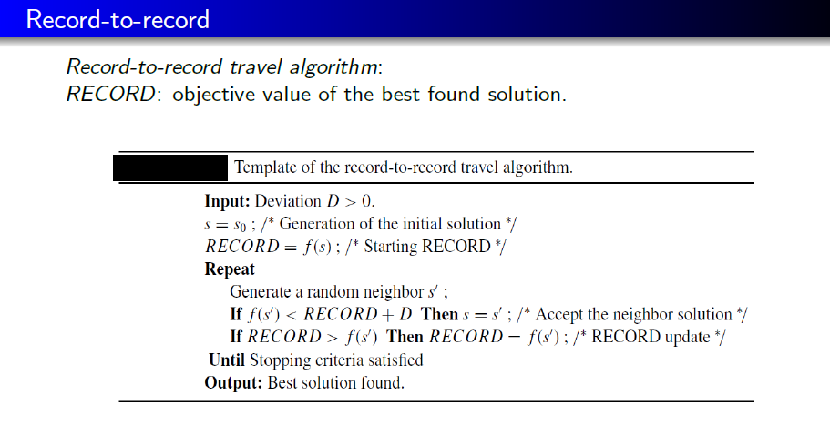
Variants of Simulated Annealing

Slide 31
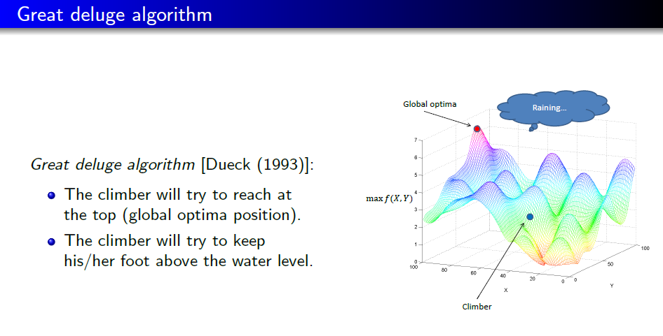

Slide 32
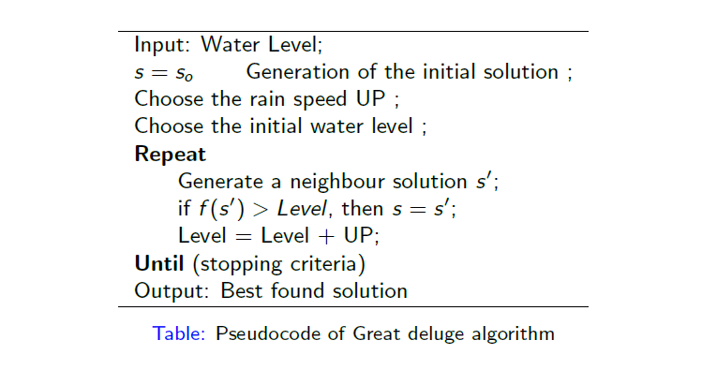

Slide 33
Conclusions
Simulated Annealing algorithms are usually better than greedy algorithms, when it comes to problems that have numerous locally optimum solutions.
Simulated Annealing is not the best solution to circuit partitioning or placement. Network flow approach to solving these problems functions much faster.
Simulated Annealing guarantees a convergence upon running sufficiently large number of iterations.

Slide 34
